Slide 1
Values and Valuation
Economic and Financial Sociology

Slide 2
Values and Valuation
Measurement, Evaluation and Valuation.
Comparison.
Rankings and Ratings.
Standards
Role of Experts and Specialists.
Limits, Tolerance, Intervals.
Gaining and Losing Value.

Slide 3
Values and Valuation
Mass, Herd, Mimetic Effects.
Scarcity, Frequence, Rarity, Identity, Antiquity, Modernity, Utility – The Valuation Regimes.
Cycles of Valuation.
Positional Value – Being the First.
Conversion and Rates of Conversion.
Metrology Problems.

Slide 4
Values and Valuation
Performativity of Value.
Certification, Approval.
Value Disputes.
Valuation and the Modern Theory of Finance.
Values and Options.
Mystification of Values – Spurious Equivalences.

Slide 5
Values and Valuation
Ethical, Aesthetical and Economic Judgments.
Tastes, Aspirations, Desires, Needs.
Chickens and Queens – The centrality of the Moment.
De Gustibus non est Diputandum.
Consistency and Transitivity.
Price and Status.

Slide 6
Values and Valuation
Creative Destruction.
Innovation
Crowd Sourcing, Crowd Financing, Crowd Casting, Viral Effects. Micro Finance.
Peer to Peer.
The 80-20 Rule.
The Lists and Recommendations.
The Fragmentation Effects.

Slide 7
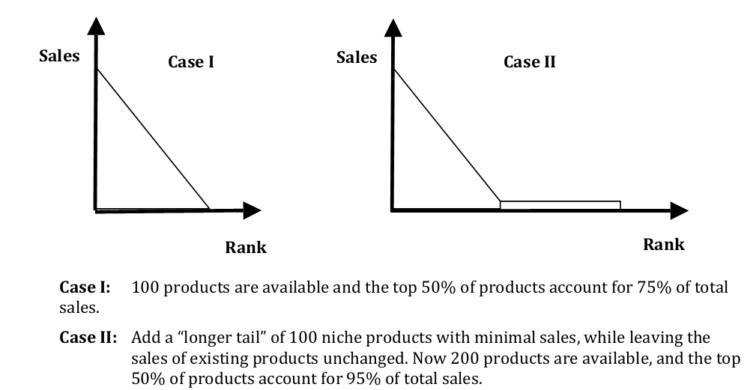
Winner Take all Society vs. the Long Tail

Slide 9
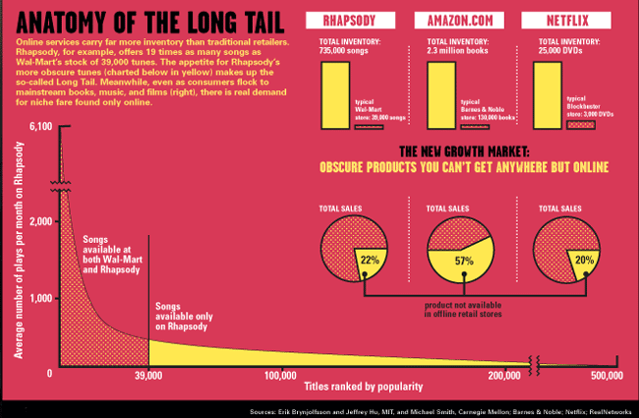

Slide 10
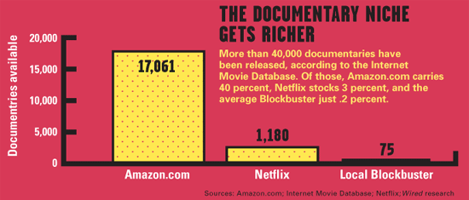

Slide 11
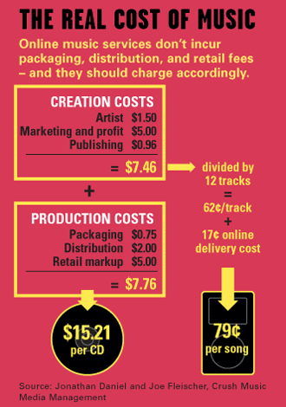

Slide 12
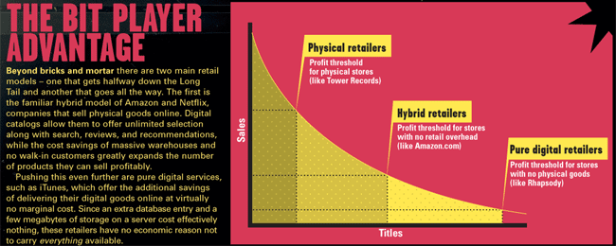

Slide 13
